Slide 1
Decision Tree

Slide 2
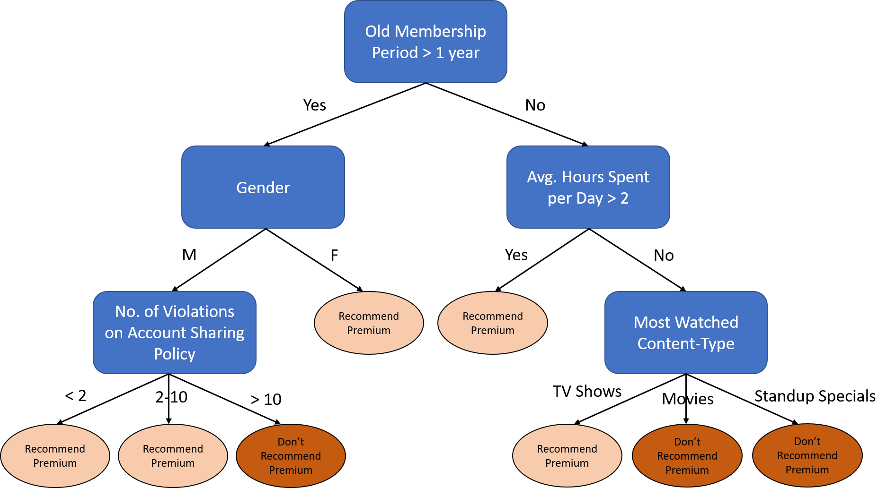
Decision Tree
A type of supervised learning algorithm.
A tree like model to make predictions
Resembles an upside-down tree
Based on the natural decision-making process
Ask a question and split the data.
Decision trees are highly interpretable
Notes:
We ask a series of questions through a nested if-then-else structure and split the data based on the answer.
Case1: The old membership period is > 1 year, gender is male, and no. of violations is < 2. -Recommend Premium

Slide 3
Types of Decision Tree
Classification tree
Regression tree
It is an algorithm where the target variable is always fixed or categorical.
The algorithm is then used to identify the “class” within which a target variable would presumably fall into.
Finite conditions
Example – To determine if the user will subscribe for a premium service or not.
It is an algorithm where the target variable is always continuous.
Output can take an infinite set of values.
Prediction or estimation.
Example – the selling price of the property.

Slide 4
Advantages of a Decision Tree
A decision tree is a tree in which each branch node represents a choice between a number of alternatives, and each leaf node represents a decision.
Graphical representation of all the possible solutions to a decision.
Decisions are based on some well-known conditions.
Decision made can be easily explained.
Decision tree can capture the non-linearity within the data set.
No need for standardization of knowledge when using tree models.

Slide 5
Terminology
Root Node
Leaf Node
Branch
Root node is from where the decision tree starts. It represents the entire dataset, which further gets divided into two or more homogeneous sets.
Leaf nodes are the final output node, and the tree cannot be segregated further after getting a leaf node.
A tree formed by splitting the tree.
Parent/Child Node
Splitting
Pruning
The root node of the tree is called the parent node, and other nodes are called the child nodes.
Splitting is the process of dividing the decision node/root node into sub-nodes according to the given conditions.
Pruning is the process of removing the unwanted branches from the tree.

Slide 6
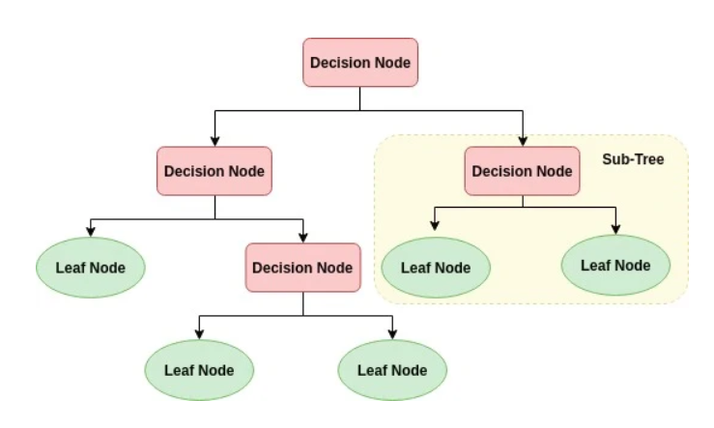
Root Node
Illustration

Slide 7
Age<=54.5
Value = [101, 88]
Class = No Disease
gender<=0.5
Value = [62, 26]
Class = No Disease
Cholesterol <=300
Value = [20, 1]
Class = No Disease
age<=40.5
Value = [42, 25]
Class = No Disease
gender<=0.5
Value = [39, 62]
Class = Disease
BP<=167
Value = [23, 14]
Class = No Disease
Cholesterol <=272.5 Value= [16, 48] class = Disease
Value= [19,0] class = No Disease
Value = [1, 1] class = No Disease
Value = [39, 19] class = No Disease
Value = [3, 6] class = Disease
Value = [23, 10] class = No Disease
Value = [0. 4] class = Disease
Value = [15, 30] class = Disease
Value = [1, 18] class = Disease
Interpreting a Decision Tree
True
False
True
False
False
False
Notes:
The problem at hand is to predict if the person has a heart disease. Based on various attributes, decision tree returns a flow-chart like diagram.
In the root node we have all the people in a group of 189 people. The values represent each class – 101 people do not have the disease while 88 have the disease. Since most of the people do not have a disease, the prediction says the group does not have a disease. So, we get a rough idea of the overall state of the situation. Now we ask a question is age <54.5. If the answer is yes, we go to left else right. Let's take the left path for an example. Now we see there is a subset of data – people whose age was less than 54.5. Again, majority have no disease, so model predicts there no disease for the group.
Gender is a binary variable 0 = female and 1 for male. So, we ask this question and again split the data based on gender. Now there are 21 females with 20 have no disease, only 1 has a disease. Final question is cholesterol is < 300. In final node there are 19 people all with no disease. Since there are no more conditions we stop here. The model concludes that a female with age<54.5, and cholesterol <=300 will not have the heart disease.

Slide 8
Constructing a Decision Tree
A top down and greedy approach
Selecting the best rule from a variable/ attribute for the split
Applying the split based on the rules obtained from the attributes
Repeating the process for the subsets obtained
Continuing the process until the stopping criterion is reached
Assigning the majority class/average value as the prediction
Recursive binary splitting/partitioning the data into smaller subsets
Notes:
2 key questions – How to choose the best split or the rule to split.
And what is the stopping criteria.

Slide 9
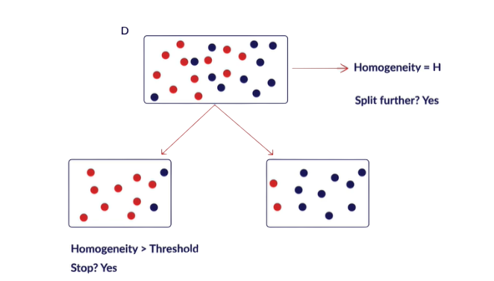
Splitting and Homogeneity
What is the objective of the split?
After the split the subsets are more homogenous or similar.
How do we quantify the homogeneity?
Regression tree - Minimal variance
Classification tree – Single label
Notes:
Now keeping the same threshold value as 70%, you can see from the below illustration that homogeneity of the first node is exactly 50%. The node contains an equal number of data points from both the class labels. Hence, you cannot give a prediction to this node as it does not meet the passing criterion which has been set. There is still some ambiguity existing in this node as there is no clarity on the label that can be assigned as the final prediction. This brings in the need for further splitting and we compare the values of homogeneity and threshold again to arrive at a decision. This is continued until the homogeneity value exceeds the threshold value.
Till the homogeneity ‘H’ is less than the threshold, you need to continue splitting the node.

Slide 10

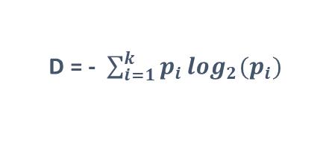

Impurity Measures
Classification Error (E)
Gini Impurity (G)
Entropy (D)
$$G=1−\sum_{i=1}^{k}{}{(p}_{i})2$$
$$E=1 −max(p_{i})$$
D = - $\sum_{i=1}^{k}{p_{i}}\log_{2}(p_{i})$
where p_{i} is the probability of finding a point with the label i, and k is the number of classes.
Impurity Measures | Case I Class 0: 20 Class 1: 80 | Case II Class 0: 50 Class 1: 50 | Case III Class 0: 80 Class 1: 20
Classification Error | 0.2 | 0.5 | 0.2
Gini Impurity | 0.32 | 0.5 | 0.32
Entropy | 0.72 | 1 | 0.72
Notes:
Lets take a couple of examples to see how these measure Different ehave in certain
Case 2 is of maximum ambiguity – so entropy has its highest possible value of 1. the higher the homogeneity, the lower the entropy.
Gini index = 0 means all points belong to same class, 0.5 means datapoints are equally distributed among different classes. The higher the homogeneity, the lower the Gini index.

Slide 11
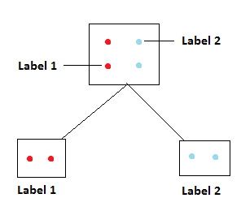

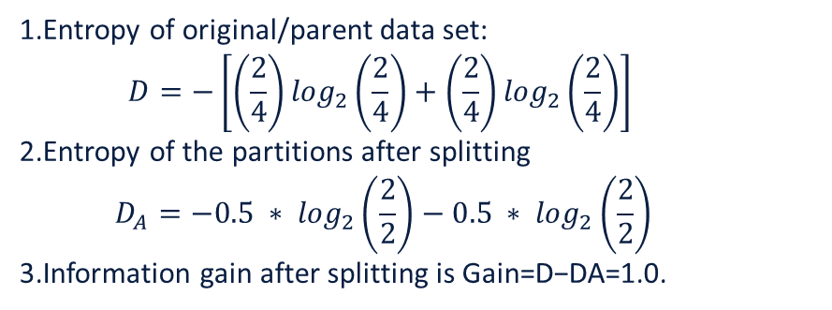
Information gain
$$Gain=D −D_{A}$$
D: The entropy of the parent set
D_{A}: The Entropy of the partitions obtained after the split
Value lies in range 0-1
The post split entropy is calculated by finding the weighted average of two child nodes.
Reduction in entropy implies information gain
Feature which gives the maximum reduction in impurity is the most important.
Entropy of original/parent data set:
$$D=−\left[\left(\frac{2}{4}\right)\log_{2}\left(\frac{2}{4}\right)+\left(\frac{2}{4}\right)\log_{2}\left(\frac{2}{4}\right)\right]$$
Entropy of the partitions after splitting
$$D_{A}=−0.5 ∗ \log_{2}\left(\frac{2}{2}\right)−0.5 ∗ \log_{2}\left(\frac{2}{2}\right)$$
Information gain after splitting is Gain=D−DA=1.0.

Slide 12
Key Requirements
Attribute-value description: Object or case must be expressible in terms of a fixed collection of properties or attributes (e.g., hot, mild, cold).
Predefined classes (target attribute values): The categories to which examples are to be assigned must have been established beforehand (supervised data).
Sufficient data: Enough training cases should be provided to learn the model.
Notes:
Fixed collection of features
Predefined and clear distinct classes for the output
Enough training data – the more the merrier

Slide 13
Steps for Training Model
Load samples
Split samples between training set and testing set
Data pre-processing
Create model based on training data
Predict class of testing data

Slide 14
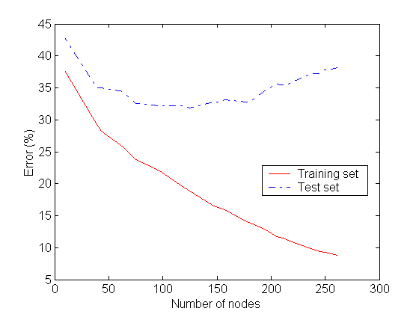
Challenges
Entire structure of the tree changes with small variation in data.
For a Decision tree sometimes, calculation can go far more complex compared to other algorithms.
Incorporating Continuous-Valued Attributes
Overfitting

Slide 15
Controlling Overfitting
Truncation - Stop the tree while it is still growing so that it may not end up with leaves containing very few data points. Truncation is also known as pre-pruning.
Pruning - Let the tree grow to any complexity. Then, cut the branches of the tree in a bottom-up fashion, starting from the leaves. It is more common to use pruning strategies to avoid overfitting in practical implementations.

Slide 16


